Slide 1
User manual
Power Plant Model Test Bench (PP-MTB)
in PSCAD
V1.8_20221127

Slide 2
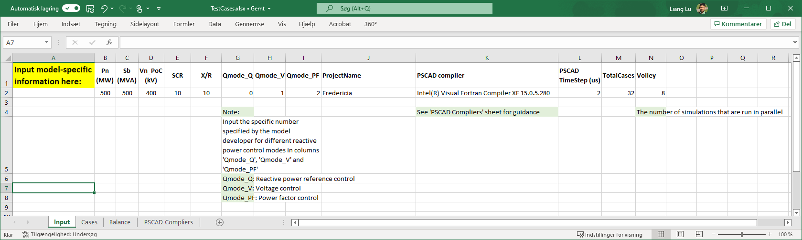
1. Model-specific information
1.1 Read relevant documentation of the model
1.2 Fill the model-specific information in the sheet ‘Input’ of the ‘TestCases.xlsx’ file
NB:
‘ProjectName’ should be the same with the name of the to-be-tested model/project (.pscx file)
Do NOT use any Danish special letters (Æ/æ, Ø/ø, Å/å)

Slide 3
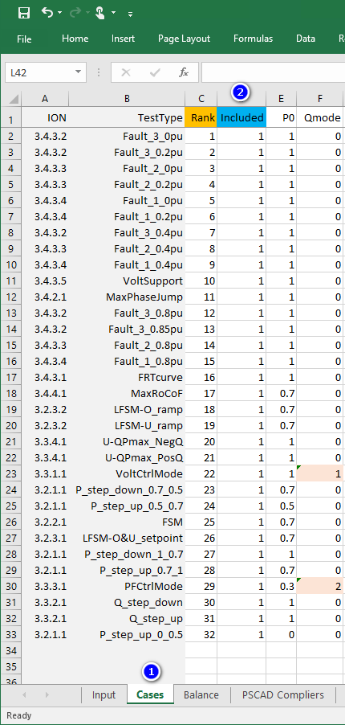
1. Model-specific information
1.3 Select all the to-be-tested cases in the sheet ‘Cases’, by inputting ‘1’ or ‘0’ in the column ‘Included’ to include or exclude a certain case.
NB:
When only a part of the total cases are selected for testing, there is NO need to change the value for ‘TotalCases’ in the sheet ‘Input’.

Slide 4
2. Model setup in pscad
2.1 Copy all the files of the model to a working folder on the server
2.2 Import/Create the workspace in PSCAD and load all the files of the model into it
If the vendor has already a workspace file (.pswx), just use it. Open PSCAD, import the workspace file, check if the model file and library files are already loaded in the workspace. If not, load them. | If the vendor does NOT have a workspace file (.pswx), then: Open PSCAD, create a new workspace and save it in the working folder. Load the to-be-tested model and its library files into the workspace.
The way to load the library files to the to-be-tested model: “To-be-tested model” -> “Resources”, right click -> “Add” -> “Binary (*.o, *.obj, *.lib)”
NB:
Do NOT use any Danish special letters (Æ/æ, Ø/ø, Å/å) in the working folder directory.
Sometimes ‘ETRAN’ library is used by the model developer, remember to load it into the workspace as well.

Slide 5
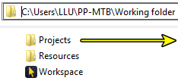
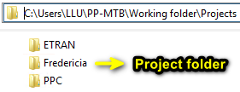
2. Model setup in pscad
2.3 Copy the following PP-MTB files and folder to the project folder
PP-MTB Library_Energinet.pslx
PP-MTB Execute_Energinet.py
TestCases.xlsx
Plot (folder)
NB:
The ‘project folder’ may not necessarily be the same with the ‘working folder’.
The project folder is where the to-be-tested model/project lies, while the working folder is the outmost folder that contains everything and also normally where the workspace file lies.
Most of the time they are the same; they are different when the directory structure is like:
in which a to-be-tested model ‘Fredericia.pscx’ lies

Slide 6
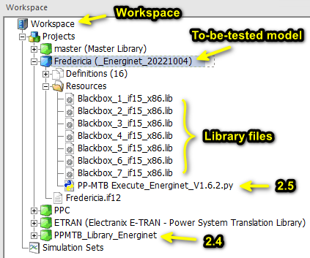
2. Model setup in pscad
2.4
Load
‘PP-MTB Library_Energinet.pslx’
to the workspace.
2.5
Load
‘PP-MTB Execute_Energinet.py’
to the to-be-tested model.
After doing, it looks like:
“To-be-tested model” ->
“Resources”, right click ->
“Add” ->
“Script\Apps (*.py, *.exe, *.bat)” ->
Choose
“PP-MTB Execute_Energinet.py”

Slide 7
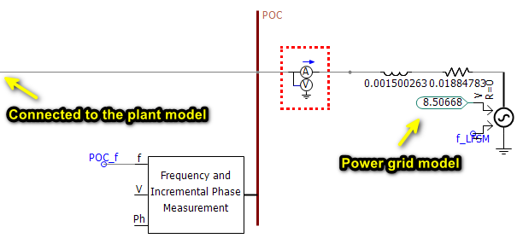
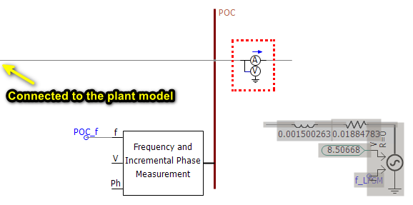

2. Model setup in pscad
2.6 Disconnect and disable the power grid part (from the PoC) in the to-be-tested model
NB: Sometimes the plant model has some measurements at PoC, which however are placed on the grid side (shown above in red dotted box). In such case, keep them connected to PoC. Otherwise, the model may not work without such measurements.

Slide 8
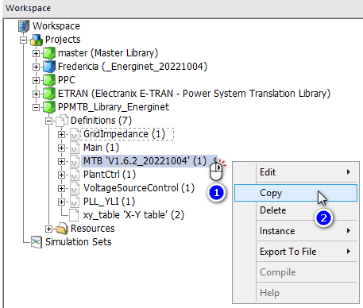
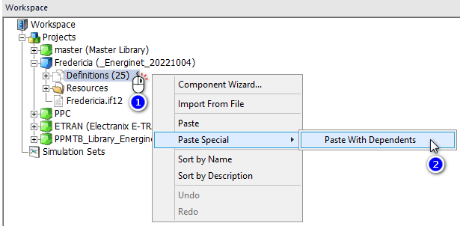


2. Model setup in pscad
2.7 Copy the Model Test Bench ‘MTB’ in the ‘PPMTB_Library_Energinet’ to the to-be-tested model and connect it at PoC.
“To-be-tested model” -> “Definitions”, right click -> “Paste special” -> “Paste With Dependents”
“PPMTB_Library_Energinet” -> “Definitions” -> “MTB”, right click -> “Copy”

Slide 9
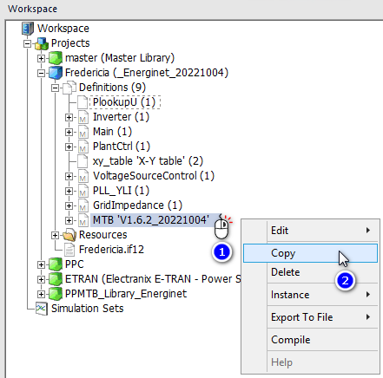
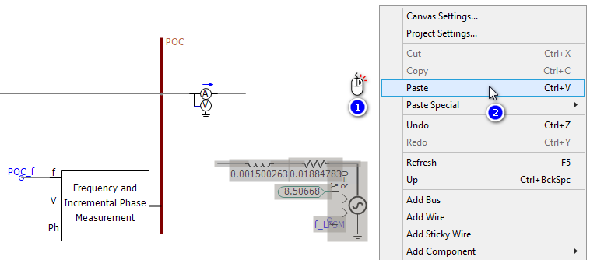


2. Model setup in pscad
2.7 Copy the Model Test Bench ‘MTB’ in the ‘PPMTB_Library_Energinet’ to the to-be-tested model and connect it at PoC.
Right click on the canvas of the to-be-tested model -> “Paste”
“To-be-tested model” -> “Definitions” -> “MTB”, right click -> “Copy”

Slide 10
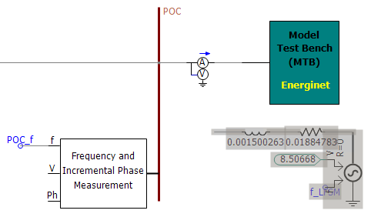

2. Model setup in pscad
2.7 Copy the Model Test Bench ‘MTB’ in the ‘PPMTB_Library_Energinet’ to the to-be-tested model and connect it at PoC.
Connect the MTB block at the PoC of the to-be-tested model

Slide 11

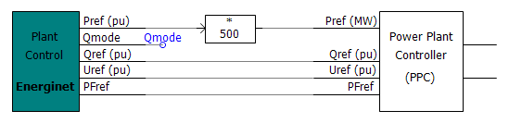

2. Model setup in pscad
2.8 Go inside the ‘MTB’ block, cut the ‘Plant Control’ block, paste it at a proper location in the to-be-tested model, and connect it properly with control/input signals of the model.
The outputs of the ‘Plant Control’ block are in per unit. Adaptions may be needed if the reference signals to the model are in physical units.
Model developer’s Power Plant Controller (PPC)
The ‘Plant Control’ block generates active power reference and reactive power control mode and reference signals
Some reference signals are sent to the PPC by exterior interfaces
Some reference signals are sent to the PPC by interior settings, for example ‘Qmode’ here. By right clicking on PPC and choosing ‘Edit Parameters’, put ‘Qmode’ in the correct cell in the settings.

Slide 12
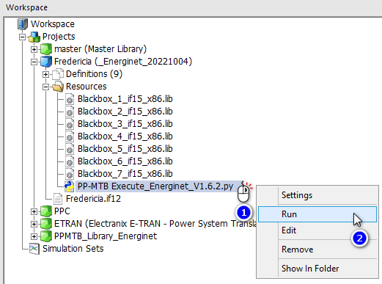
3. execute
By one click, the script does both simulation and plotting of results automatically.
“To-be-tested model” -> “Resources” -> “PP-MTB Execute_Energinet”, right click -> “Run”

Slide 13
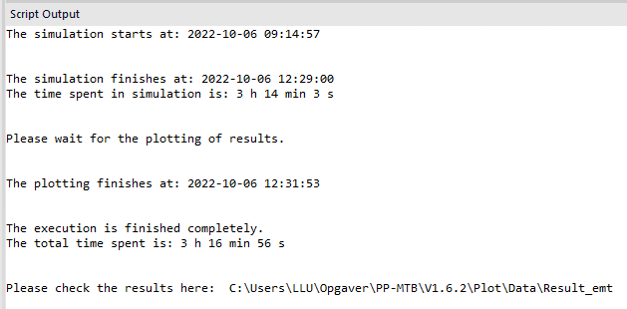
4. finish
After running the script, the ‘Script Output’ window looks like:

